Slide 1
Your Guide to Job Development and Creating
Successful Employment Partnerships for Students
Presented By: Corey Fineran & Lindsay Zerull
Transition Curriculum, Inc
NextUp Transition Curriculum

Slide 2
Creating or identifying competitive job opportunities that align with students’ skills, interests, and needs
Providing ongoing support and feedback to students in the competitive workforce
Making meaningful connections/partnerships with businesses in your community
What is
Job Development?
Job Development is NOT training opportunities

Slide 3
For the student
Employment rate is 75% for people without disabilities and 35% for people with disabilities
Opportunity to practice and build hard and soft skills
For businesses and the community
Opportunity to teach best practices
Section 503 of Rehabilitation Act and Work Opportunity Tax Credit
Allows us to act as an employment agency for the business
Companies that lead on disability inclusion - 1.6x more revenue over competitive peers
Why does Job Development matter?
Companies that Lead in Disability Inclusion Outperform Peers Financially, Reveals New Research from Accenture. (2023). https://newsroom.accenture.com

Slide 4
What is your experience with job development?
How have you struggled with job development?

Slide 5
Scheduling
Collaboration
Transportation
Family
Barriers

Slide 6
In 2025, a student who is regularly attending school can earn:
$2,350/month
$9460/year
without it counting against their SSI benefits
Student
Earned-Income Exclusion

Slide 7
Scheduling
Collaboration
Transportation
Family
Rural Areas & Job Market
Lack of Awareness
Barriers

Slide 8
Match student skills and preferences to job roles
Step #1: Discover your student’s strengths, interests, and
needs
Step #2: Familiarize yourself with businesses in your
community
Step #3: Match student’s skills and preferences to job
roles
Step #4: Determine if role customization is necessary
Laying the
Groundwork

Slide 9
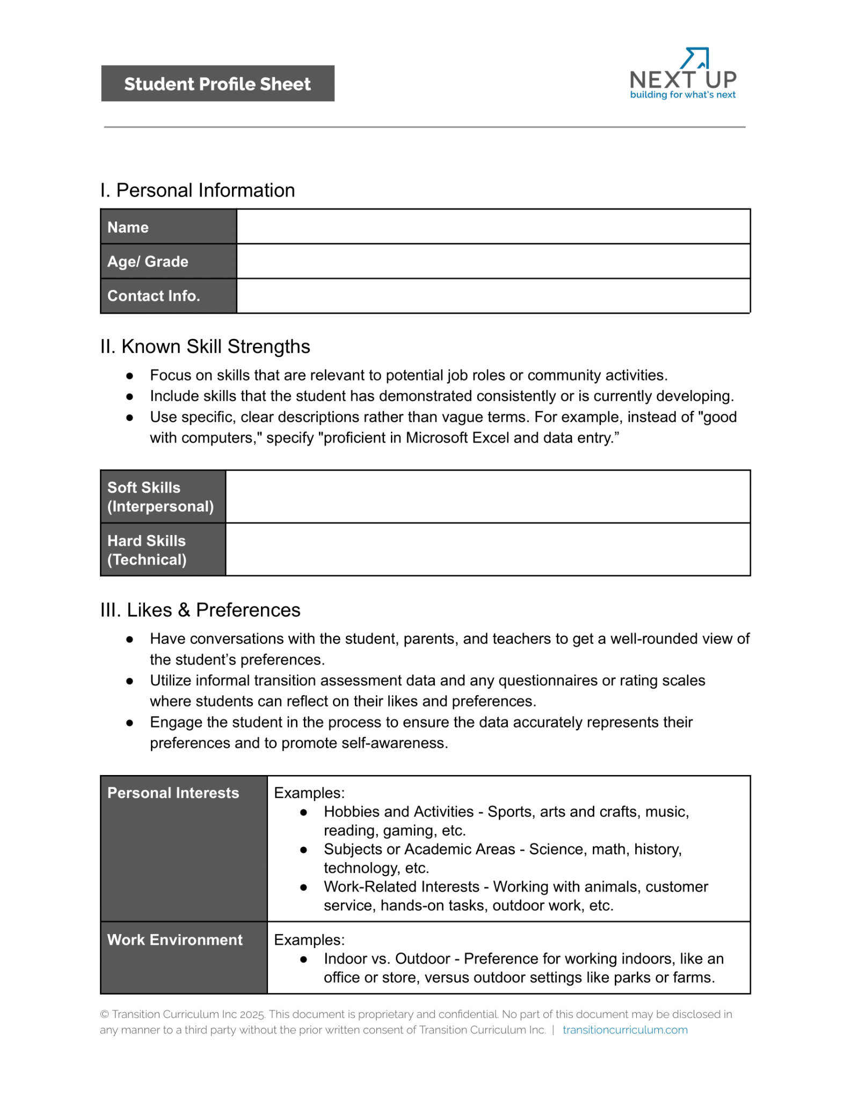
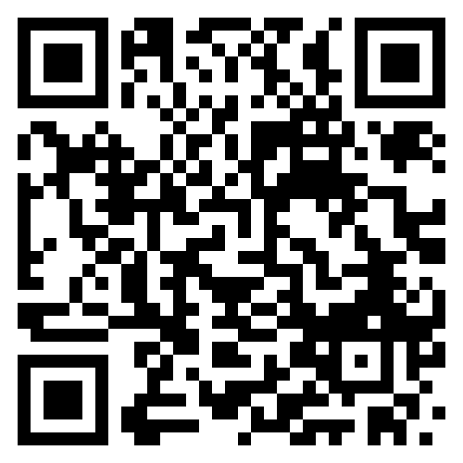

Slide 10
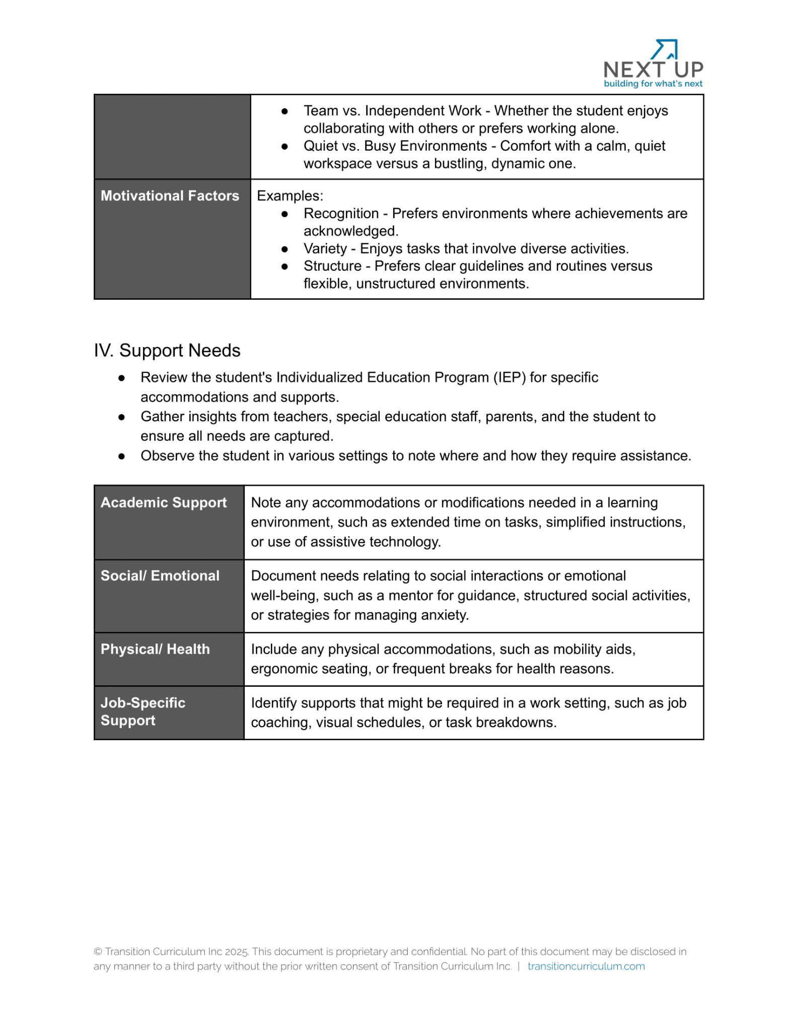

Slide 11
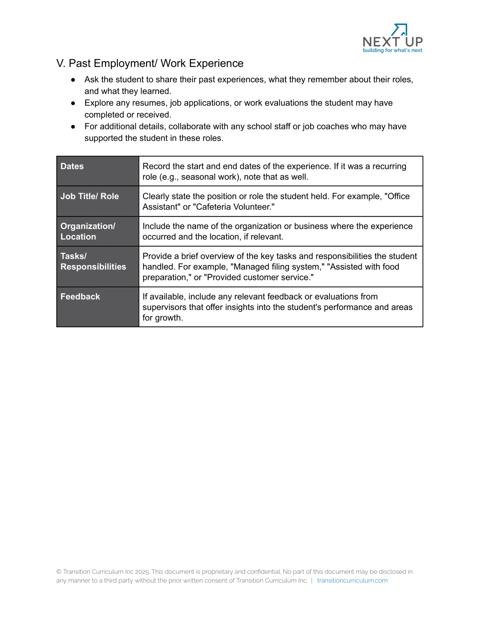

Slide 12
Match student skills and preferences to job roles
Step #1: Discover your student’s strengths, interests, and
needs
Step #2: Familiarize yourself with businesses in your
community
Step #3: Match student’s skills and preferences to job
roles
Step #4: Determine if role customization is necessary
Laying the
Groundwork

Slide 13
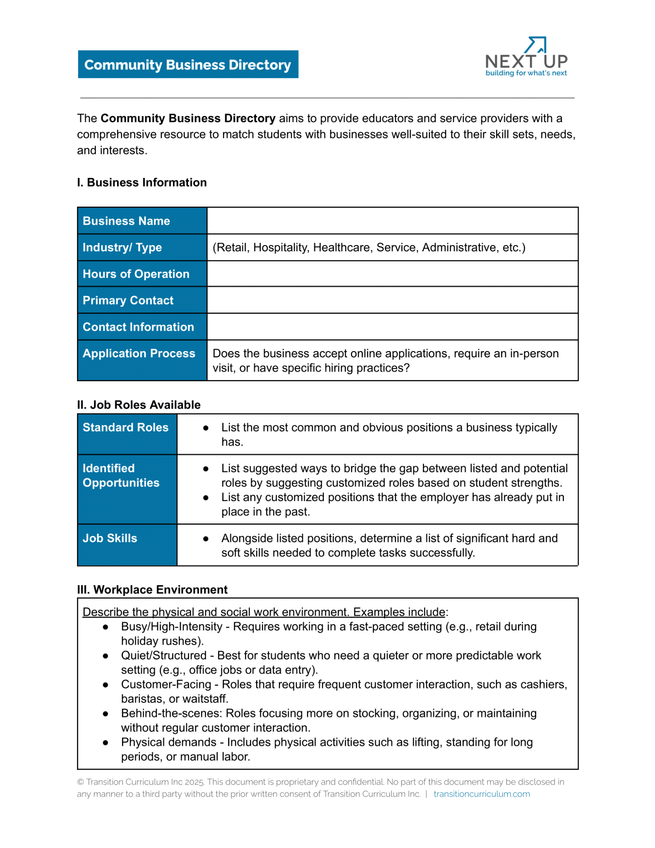
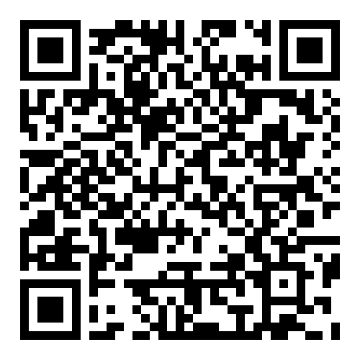

Slide 15
Match student skills and preferences to job roles
Step #1: Discover your student’s strengths, interests, and
needs
Step #2: Familiarize yourself with businesses in your
community
Step #3: Match student’s skills and preferences to job
roles
Step #4: Determine if role customization is necessary
Laying the
Groundwork

Slide 16
How do you create successful partnerships?

Slide 17
Discovering business connections in the community
Establishing business connections in the community
Maintaining business connections in the community
Creating Successful Partnerships

Slide 18
Discovering Business Connections in the Community
Learn about the community
Be a patron
Research
Visit your town hall
Join the Chamber of Commerce and other organizations
Methods
Network with families and staff within your building
Create a Job Developer’s Network group
Utilize LinkedIn or other employment-related resources
Creating Successful Partnerships

Slide 19
Establishing Business Connections in the Community
First Contact
Introduce yourself with a strong opening statement
Schedule time to learn more about the business
Use a Job Development Log
Second Contact
Learn about their business and staffing pain-points
Use Community Business Directory for guiding questions
Provide general information on your program (elevator pitch)
Third Contact
Talk about your program in more detail, including ongoing support
Address how you can help solve the problems they mentioned
Share successful partnerships with other businesses
Get information on hiring process
Discuss potential applicants or future connections
Creating Successful Partnerships

Slide 20
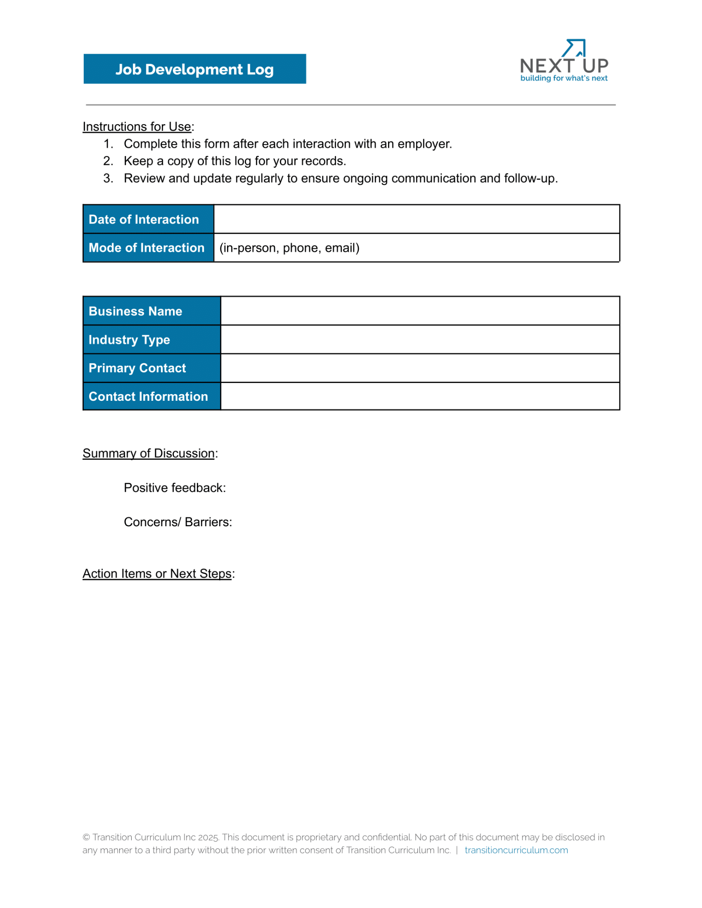
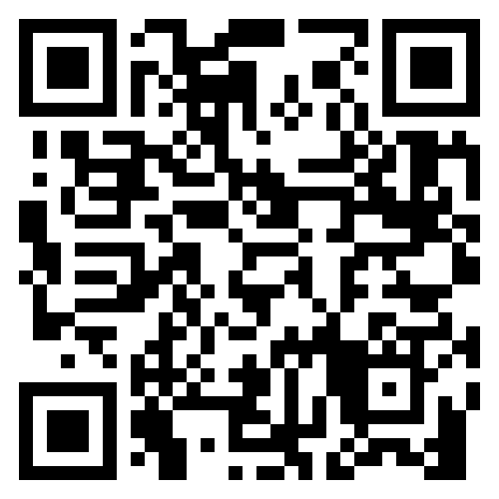

Slide 21
Establishing Business Connections in the Community
First Contact
Introduce yourself with a strong opening statement
Schedule time to learn more about the business
Use a Job Development Log
Second Contact
Learn about their business and staffing pain-points
Use Community Business Directory for guiding questions
Provide general information on your program (elevator pitch)
Third Contact
Talk about your program in more detail, including ongoing support
Address how you can help solve the problems they mentioned
Share successful partnerships with other businesses
Get information on hiring process
Discuss potential applicants or future connections
Creating Successful Partnerships

Slide 22
Maintaining Business Connections in the Community
Maintain regular communication while being cognizant of the employer’s time
Be prepared for a student evaluation process or progress monitoring
Acknowledge the business and employers
Design classroom opportunities to target work behaviors
Creating Successful Partnerships

Slide 23
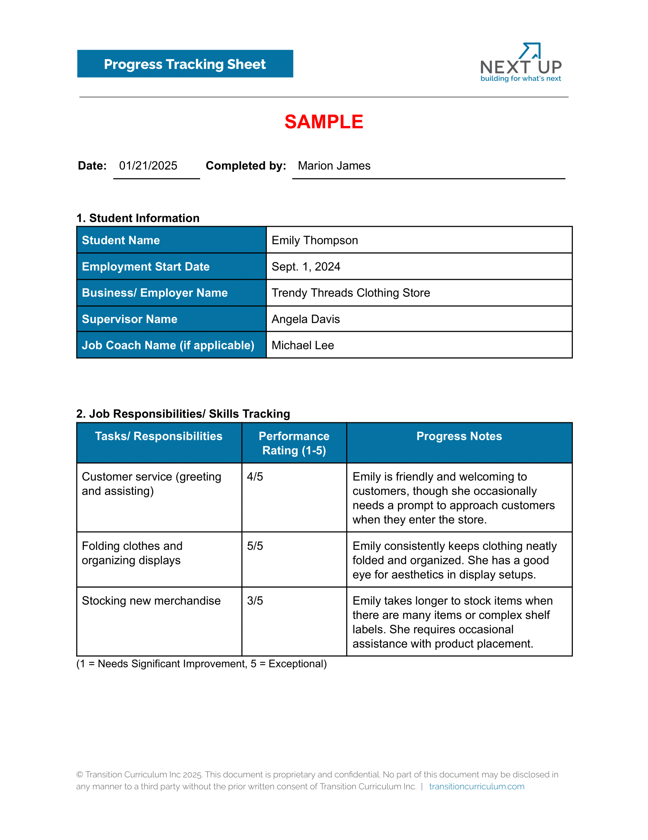
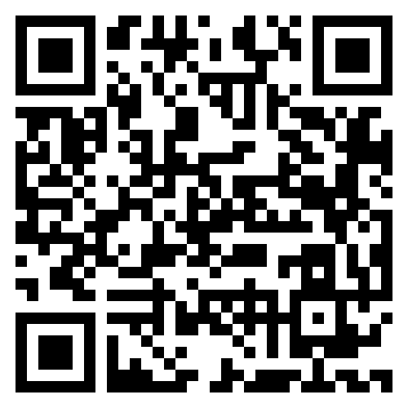

Slide 24
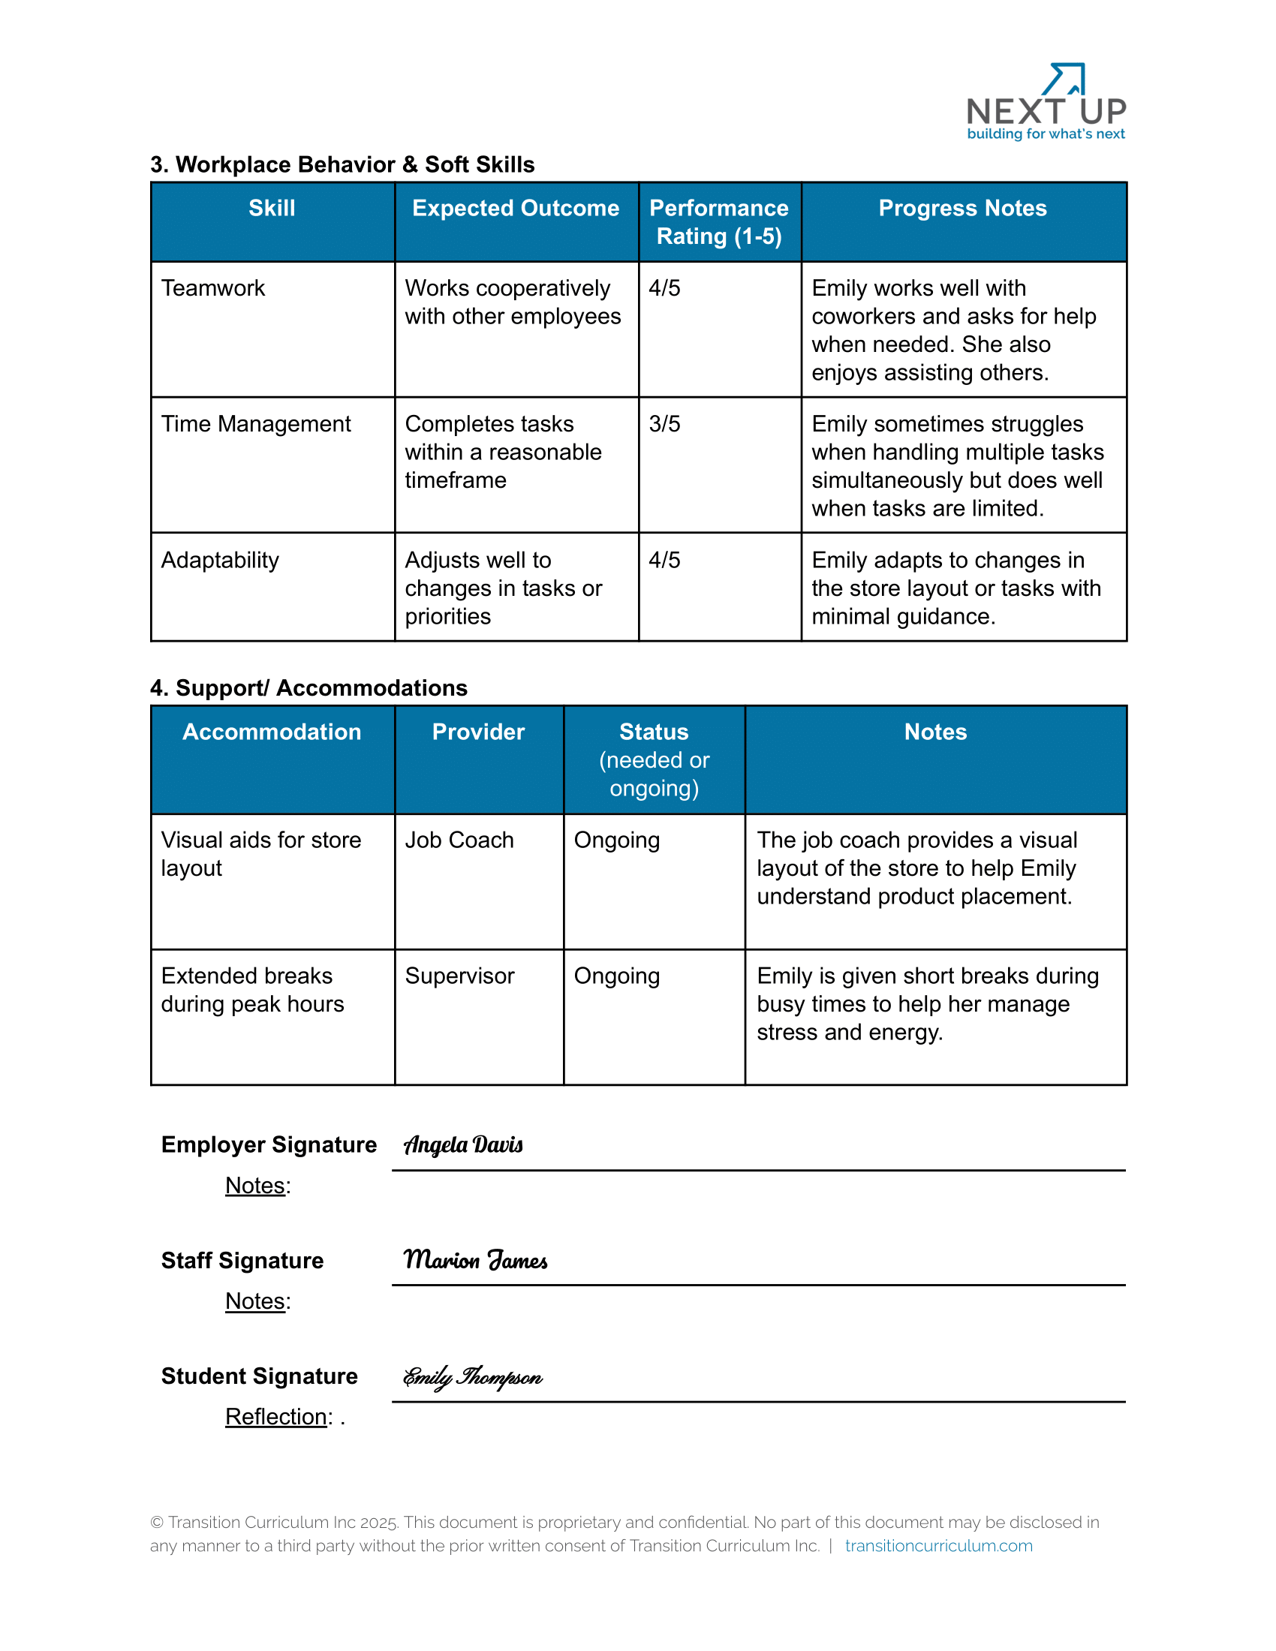

Slide 25
Maintaining Business Connections in the Community
Maintain regular communication while being cognizant of the employer’s time
Be prepared for a student evaluation process or progress monitoring
Acknowledge the business and employers
Design classroom opportunities to target work behaviors
Creating Successful Partnerships

Slide 26
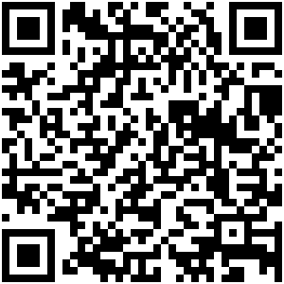
Thank you for attending!
Corey Fineran - corey.fineran@transitioncurriculum.com
Lindsay Zerull – lindsay.zerull@transitioncurriculum.com
TransitionCurriculum.com/conference

